Slide 1
How to get your dreaM JOB Resume & job hunting tips
Andy Mallon

Slide 2

Slides & content available on GitHub
PowerPoint Slides
My annotated resume
am2.co/dream-job-ppt

Slide 3
Andy Mallon
I sell furniture at the mall
Database Architect at Wayfair.com
Working with SQL Server since 2003
Background in Tech Support, Database Administration, and Database Architecture
Lazy
Impatient

Slide 4
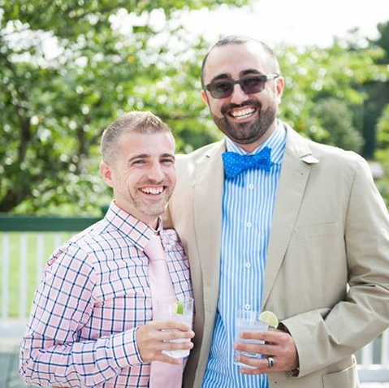
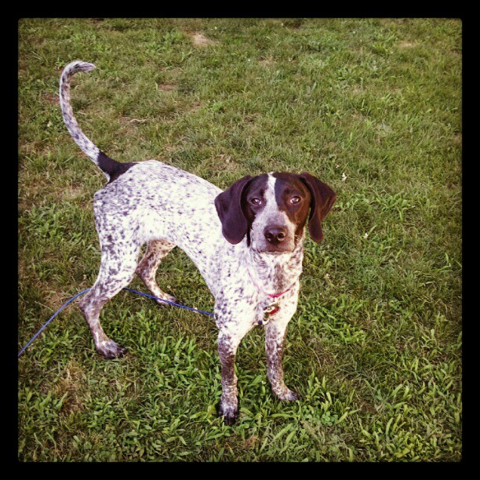


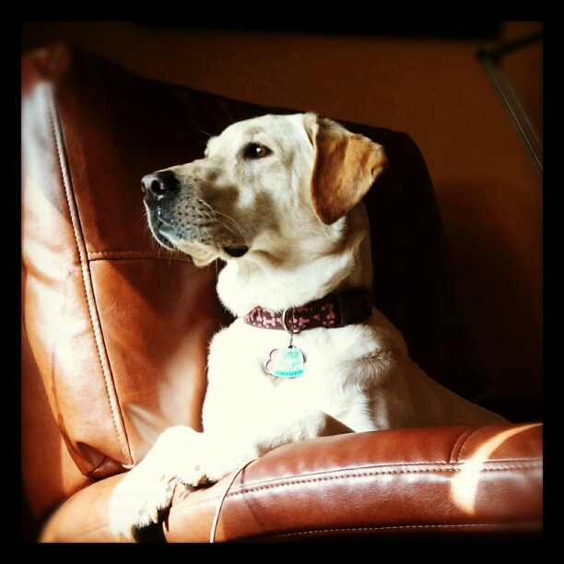

@QueeryTSQLRex
Notes:
Some of the things I love most in life– My husband, my pups, Queery the Diversity Dino.

Slide 5

http://AMtwo.lgbt

Slide 6


Contact Andy
Andy@AMtwo.co
@AMtwo
amtwo.co
andy@amtwo.co

Slide 7

Session Feedback
Tell me what you don’t like
Tell me what can be better
Tell me what you like

Slide 8


Yea…….You apparently didn’t put one of the new coversheets on your TPS reports.
I'm also gonna need you to go ahead and silence your phones and devices

Slide 9
Agenda
My story – Why I’m living my dream
Setting your career goals
WTF is a resume?
How to write a resume
How to navigate a job interviews & offers

Slide 10

Warning: I’m American
This topic is cultural
My advice comes from my experience & perspective
Tech industry
United States

Slide 11
My story: Why I’m living my dream

Slide 12






My story isn’t particularly unique
First tech job
Blogging + speaking
University
First job
First DBA job
Today

Slide 13


Education

Slide 14


My first job

Slide 15

My first tech job

Slide 16

My first DBA job

Slide 17
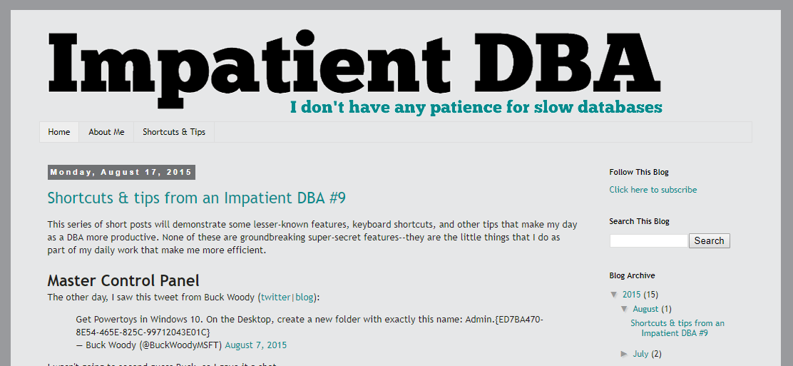
Blogging + speaking
Notes:
In May 2014, I started blogging. I wrote 3 blog posts in 2014.
In the first 12 months, I wrote 6 blog posts.
In the following 12 months, I wrote 33 blog posts, and started speaking at user groups & SQLSaturday

Slide 18

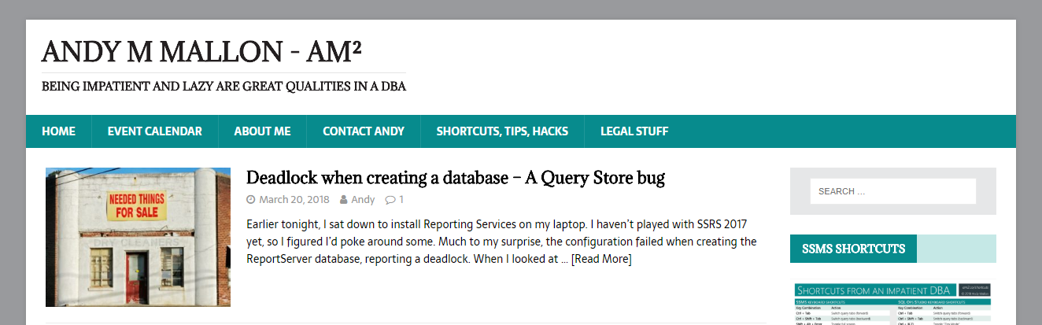



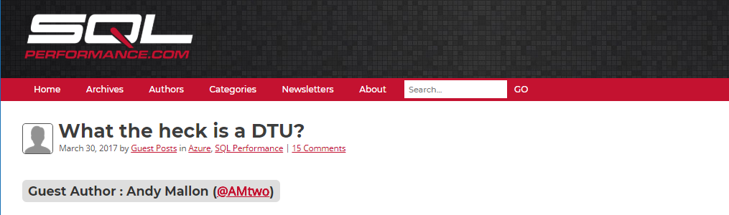

Today

Slide 19
Setting your career goals

Slide 20
What do you want to do?
“You can do anything if you put your mind to it”
This is totally a lie
I will never be an opera singer

Slide 21
Where do you want to be?
You can’t get there if you don’t know where you’re going
Do you want to be a spirulina rancher?
Do you want to work for Microsoft?

Slide 22
How can you get there?
It doesn’t have to be a direct route
Everyone has missteps & detours
My path to here hasn’t exactly been direct…

Slide 23
Who can help you get there?
Networking is important
Referrals / references are important
Sponsorship / mentorship can be tremendously helpful

Slide 24
WTF is a resume?

Slide 25


What is the purpose of your resume?
It’s to get a new job, right?
Nope
Your resume gets you an interview
Your interview gets you a job

Slide 26
How to write a bad resume

Slide 27

Bad resumes are…
Sloppy
Long
Repetitive
Inconsistent
Ugly
Careless
Unprofessional

Slide 28
Avoid these common pitfalls
Irrelevant jobs don’t belong on your resume
Is “perfume counter at Macy’s” relevant?
Don’t repeat the same thing for every job
“Responsible for backup & recovery” is implied in DBA
Put it on the most relevant job

Slide 29
Be professional
Professional tone
Professional language
Professional formatting

Slide 30
Be yourself
Don’t over-sell yourself
Don’t under-sell yourself
Don’t hide your personality

Slide 31
Professional Email Address
Use your name
Don’t give away your age
Use a professional domain
Don’t use BostonHottieGuy666@butz.com

Slide 32
How to write a good resume

Slide 33

Good resumes are…
Tidy
Concise
Accurate
Pretty
Thoughtful
Professional
Tell a story

Slide 34
Nobody wants to read your resume
Start with the most important bits
Grab the reader’s attention early
Understand the inverted pyramid
Don’t bury the lede

Slide 35
Most résumé-worthy
Important details
Other info
Who
What
When
Where
Why
Notable projects
Major accomplishments
Current job information
Complete relevant work history
Additional details on notable projects
Education history

Slide 36
Inverted Pyramid
If someone stops reading ½ of a page in…
Did they get a good initial picture of you?
Did you want to tell them something else?
You should feel good about their decision

Slide 37
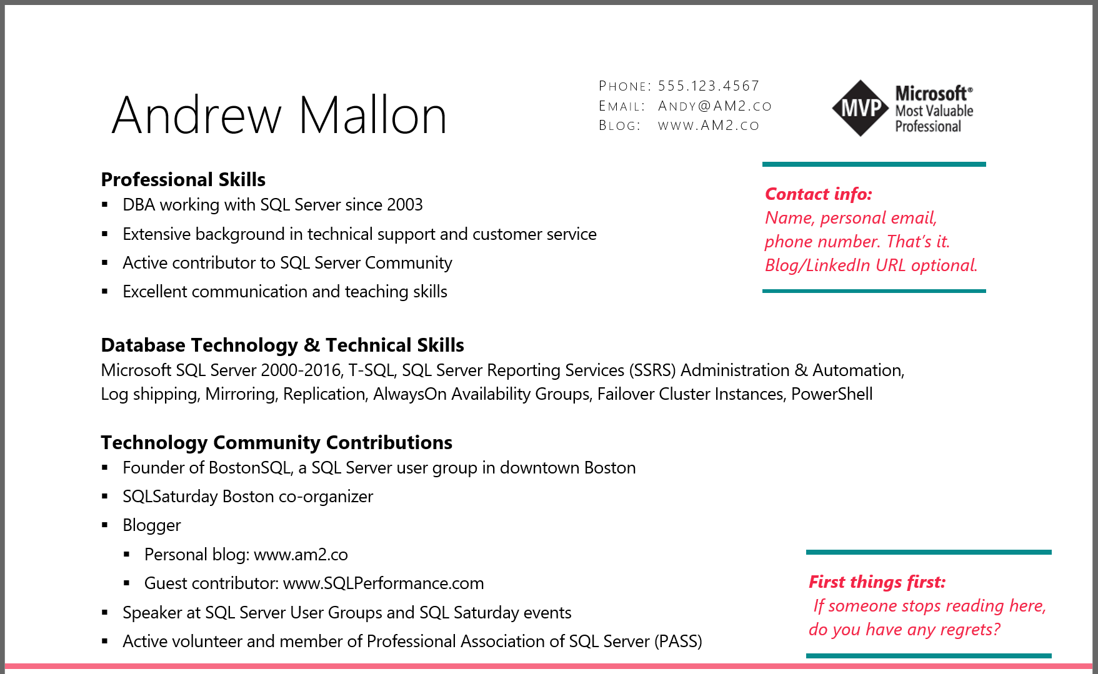

Slide 38



Spice up your experience with detail
Boring
Exciting
Responsible for backups and restores of SQL Server databases.
Standardized backup process across all 100 servers in environment; Implemented automated process to regularly test restores of every database.

Slide 39


Spice up your experience with detail
Boring
Exciting
Performance tuned queries
Reduced CPU utilization by 20% over 6 months, by focusing on performance in code review, as well as proactive performance monitoring & tuning

Slide 40
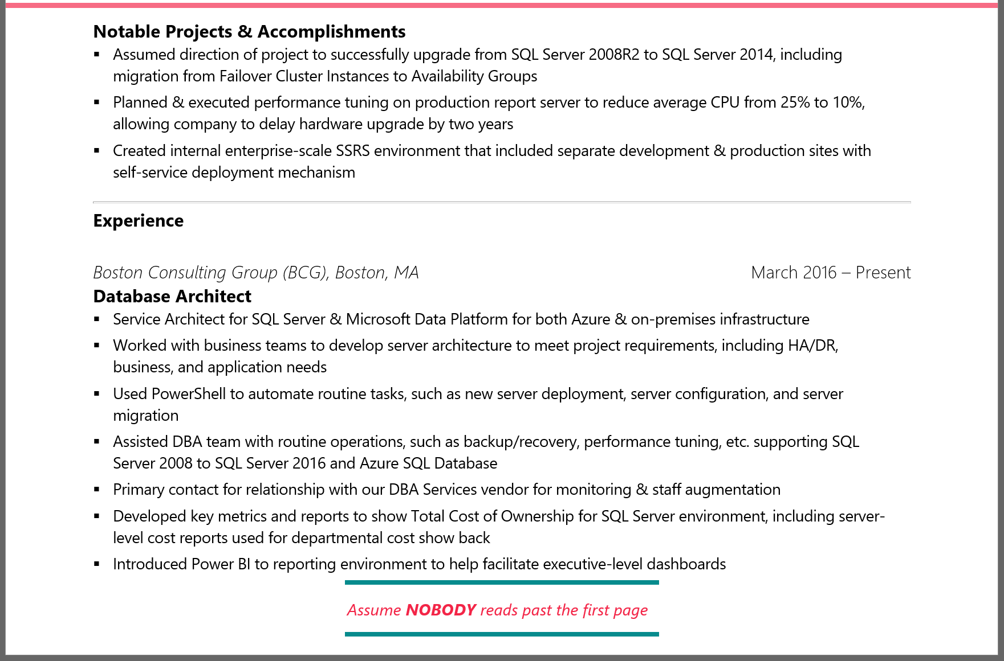
Notes:
I’m no longer with the Boston Consulting Group—This is a slightly dated resume…

Slide 41
Hide important facts about yourself
Are you a woman?
Are you a minority?
Are you young? Old?
Are you a “protected class”?
Why might someone have implicit bias against you?

Slide 42
What is “implicit bias”
Implicit stereotypes are based on learned associations between various qualities and social categories, including race or gender.
Individuals' perceptions and behaviors can be affected by implicit stereotypes, even without the individuals' intention or awareness.
Notes:
The keyword here is *LEARNED* … Society teaches us these things, not always experience.

Slide 43
What is “implicit bias”
Implicit stereotypes are based on learned associations between various qualities and social categories, including race or gender.
Society teaches us to associate stereotypes & bias based on these qualities, despite experience to the contrary
Notes:
The keyword here is *LEARNED* … Society teaches us these things, not always experience.

Slide 44
What is “implicit bias”
If you’re not a straight white dude…
Someone might hold that against you…
And not even realize it

Slide 45
Examples of “Implicit bias triggers”
Stereotypical names around gender or ethnicity
J. Jones instead of Jamal Jones
K.D. Lang instead of Kathryn Dawn Lang
Historically black/female colleges
Year of graduation
“Smith College, 1982”

Slide 46
How to navigate a job interview

Slide 47

Be prepared
Research the company
Check LinkedIn for connections
Research the position

Slide 48

Be prepared
What do you want to learn from them?
What do you want them to learn from you?

Slide 49
Be yourself
You are better at being you than you are at being someone else
They are hiring you
If you land the job, they’ll meet “the real you” eventually

Slide 50
Dress appropriately
You don’t always have to wear a suit!
What’s the best-dressed day you would have at this job?
Dress for that day

Slide 51

Tell your story

Slide 52
How to navigate a job offer

Slide 53
Is the job right for you?
Will you be happy?
People
Work
Commute
Money
Work-life balance

Slide 54
Is the employer right for you?
Industry
Management
Team dynamics
Socio-political leanings

Slide 55
Questions?
am2.co/2016/07/job-hunting-database-professionals/

Slide 56
Resources
Andy’s professional development musings
https://am2.co/category/professional-development/
Steph Locke’s one-page CV template
https://www.overleaf.com/articles/steph-lockes-one-page-cv/wbttfmfqcdtq
Write a killer technical resume in five steps
https://www.brentozar.com/archive/2012/09/write-killer-technical-resume-five-steps/
Rie Irish “Let Her Finish” webinar
https://youtu.be/ib04UR2KRMc?t=6m05s

